Slide 1
Abbeville v.
The State of South Carolina, et al.

Slide 2
Legal Issues in Abbeville
The trial of this case does not come to us on a blank slate
The Supreme Court has said that in addition to adequate and safe facilities, the legislature must provide each child the opportunity to acquire
  a “minimally adequate education,” which the Supreme Court broadly outlined as:
    The ability to read, write, and speak the English language, and knowledge of mathematics and physical science;
    A fundamental knowledge of economics, social, and political systems, and of history and governmental processes; and
    Academic and vocational skills

Slide 3
The South Carolina Constitution Mandates:
“The general Assembly shall provide for the maintenance and support of a system of free public schools open to all children in the state.” S.C. Const. Act XI, §3

Slide 4
Why Do We Need A Law Suit?

Slide 5
What Do The Test Results Show?
Below basic percentages 2003 PACT scores
Allendale
49% Math
57% Eng.
Dillon 2
38% Math
42% Eng.
Florence 4
48% Math
50% Eng.
Hampton 2
59% Math
54% Eng.
Jasper
54% Math
53% Eng.
Lee
51% Math
51% Eng.
Marion 7
52% Math
54% Eng.
Orangeburg 3
44% Math
44% Eng.

Slide 6
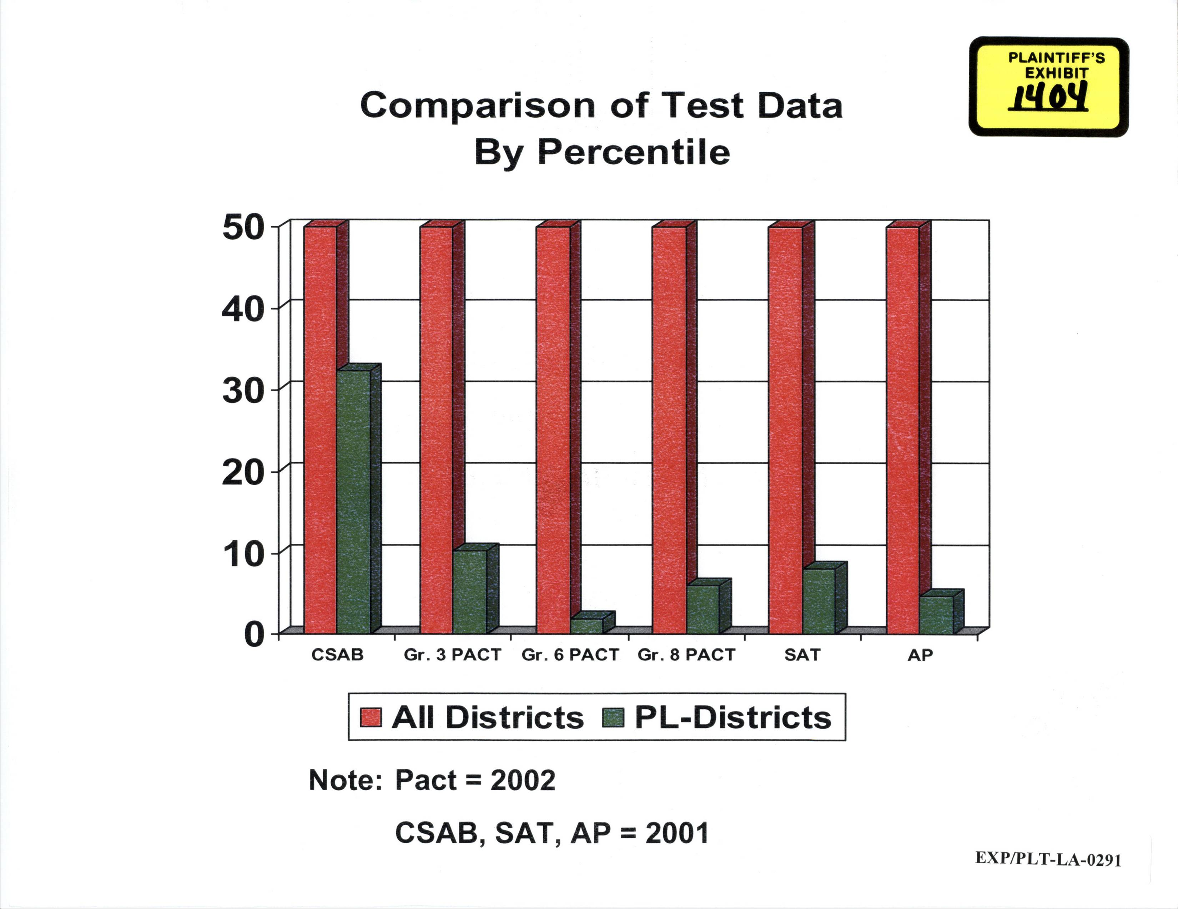
A

Slide 7
Who Are
The Plaintiffs?

Slide 8
The Plaintiffs are:

Slide 9
The Plaintiffs are:

Slide 10
Percentage of Schools Unsatisfactory and Below Average State vs. Plaintiff Districts, 2003
Plaintiff
Districts
75%
State
17.4%

Slide 11
Percentage Schools in Plaintiff Districts Rated Unsatisfactory or Below Average 2001 to 2003
79% of schools in plaintiff districts ranked U or BA 3 years in a row
87% of schools in plaintiff districts rated U or BA at least once over three years

Slide 12
Percentage Schools in Plaintiff Districts Moving out of Unsatisfactory or Below Average Ratings between 2001 and 2003
12.5% moved to
Average or above in 2003

Slide 13
Are Children Receiving/Realizing Adequate Educational Opportunities
Drop out rates:
Allendale
60%
Dillon 2
43%
Florence 4
66%
Hampton 2
54%
Jasper
61%
Lee
67%
Marion 3
44%
Marion 4
44%
Orangeburg 3
48%

Slide 14
Brown v. Board of Education
347 U.S. 483 (1954)
“We conclude that in the field of public education the doctrine of “separate but equal” has no place. Separate educational facilities are inherently unequal.”

Slide 15
Hampton County Profile:
Ethnicity
South Carolina Education Profiles 2001

Slide 16
Hampton 2 Education Profile:
Student Ethnicity
South Carolina Education Profiles 2001

Slide 17
Lee County Profile
Ethnicity
South Carolina Education Profiles 2001

Slide 18
Lee County Education Profile:
Student Ethnicity
South Carolina Education Profiles 2001

Slide 19
Jasper County Profile:
Ethnicity
South Carolina Education Profiles 2001

Slide 20
Jasper County Education Profile:
Student Ethnicity
South Carolina Education Profiles 2001

Slide 21
Student Characteristics and Teacher Qualifications For Plaintiff & Non-Plaintiff Districts

Slide 22
Student Characteristics and Teacher Qualifications For Plaintiff & Non-Plaintiff Districts

Slide 23
Student Characteristics and Teacher Qualifications For Plaintiff & Non-Plaintiff Districts

Slide 24
Student Characteristics and Teacher Qualifications For Plaintiff & Non-Plaintiff Districts

Slide 25
Some Say
Let’s Wait
And See

Slide 26
Gov. Miles McSweeney
1903 General Assembly Address
“Yet the bare facts of the condition of the average school in some counties are shocking.”
“If the Legislature will discharge its responsibility to the cause of education in its entirety in the State, there must be State aid to the public schools.”

Slide 27
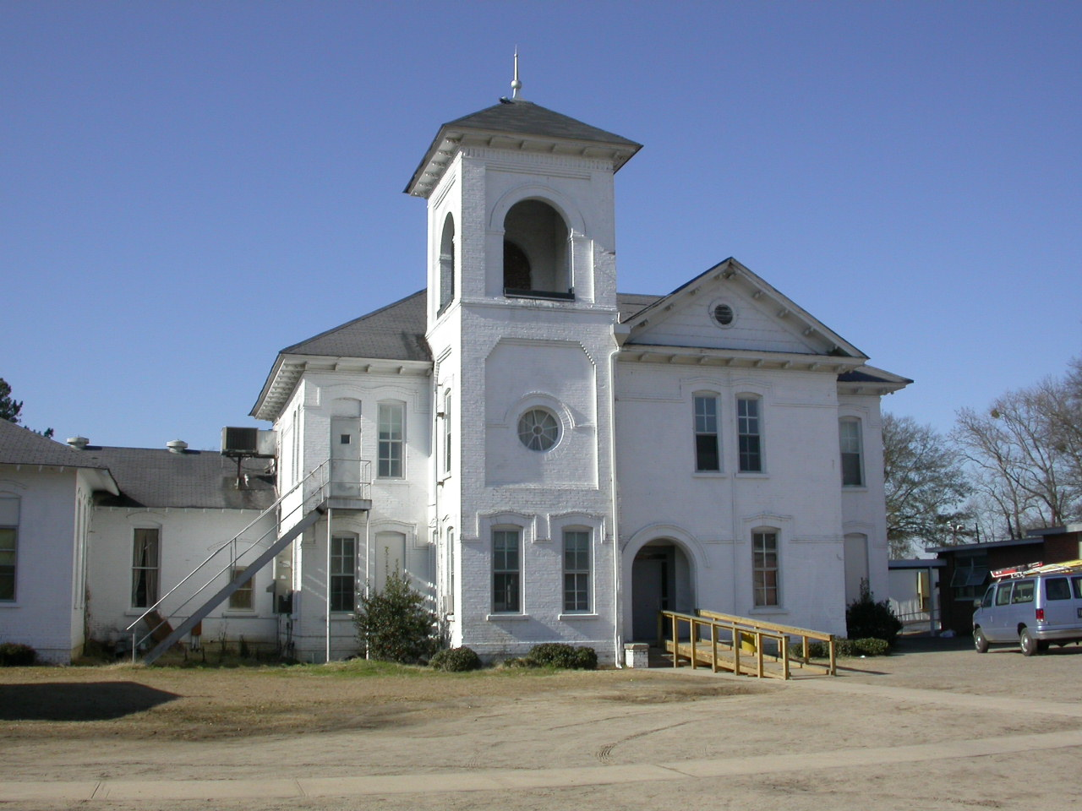

Slide 28
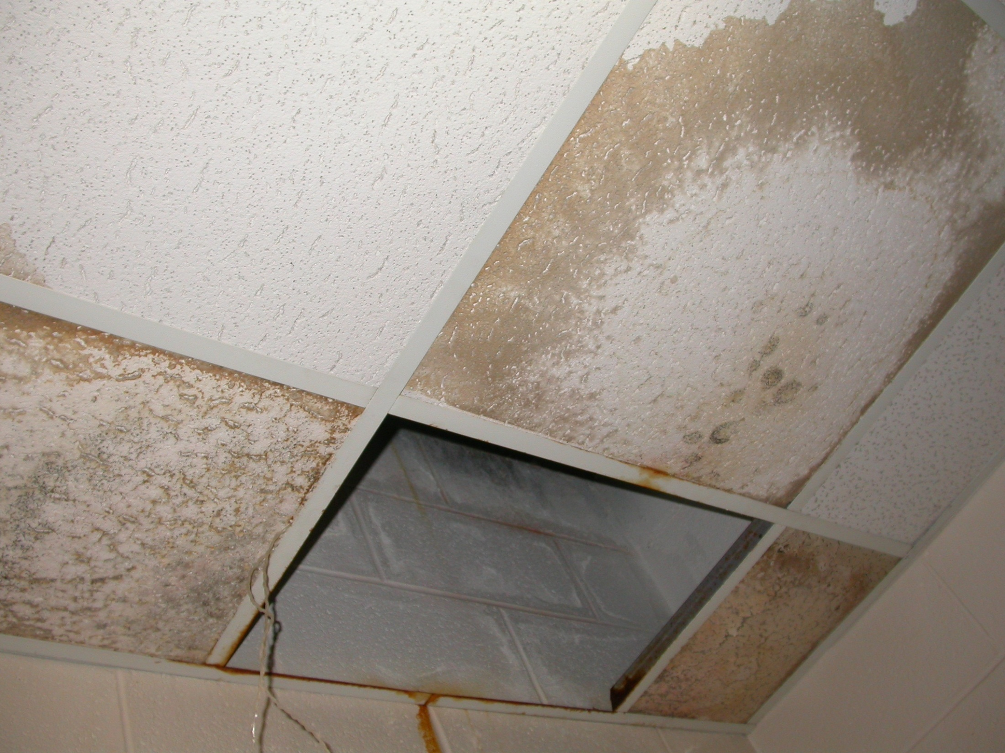

Slide 29
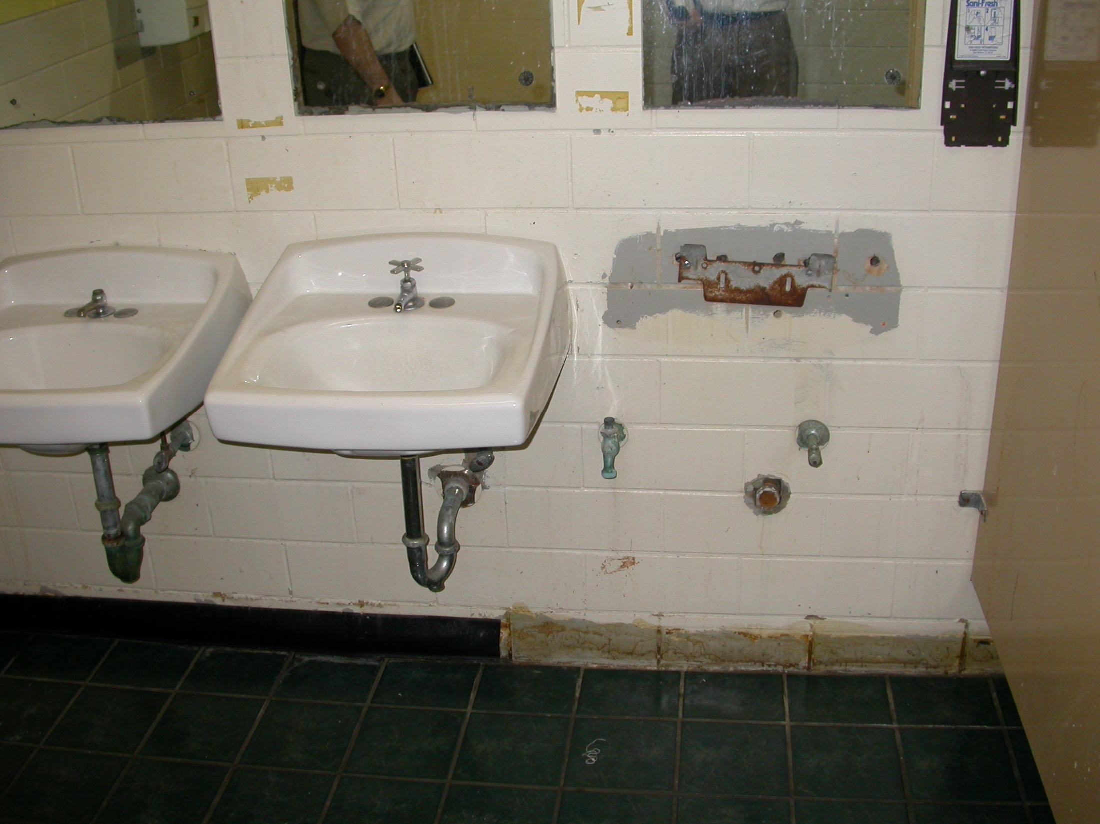

Slide 30
Gov. Coleman Blease
1913 Second Inaugural Address
“If you will travel through the country and see the unclean, uncomfortable, ragged and unpatched – to express it in a word, most miserable looking buildings, that are called school houses, and not feel ashamed of what your State is doing for the education of her future citizens, then surely you have no sense of shame. Gentleman, I can not paint the picture too black – school houses with holes in the walls and floors and roofs, where children have to huddle together to keep warm; school houses so small and so crowded that children must be so close together they actually have to breathe into their lungs the breath which comes from the bodies of others.”

Slide 31
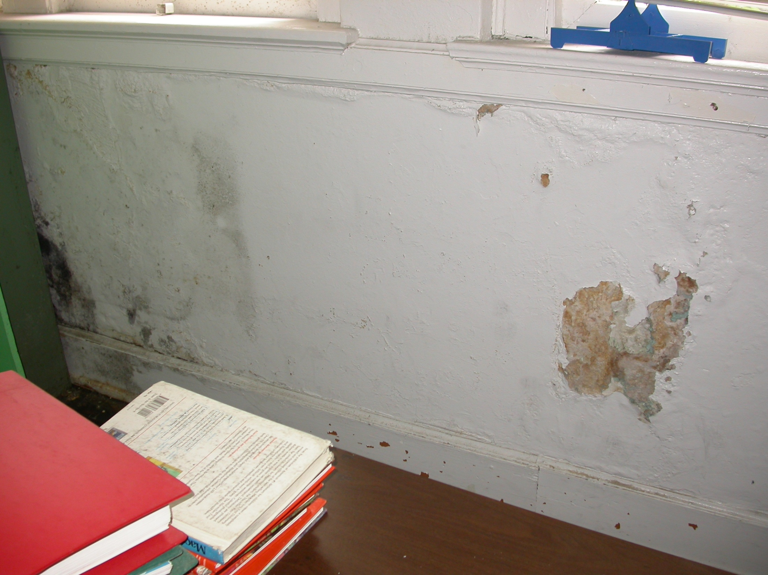

Slide 32
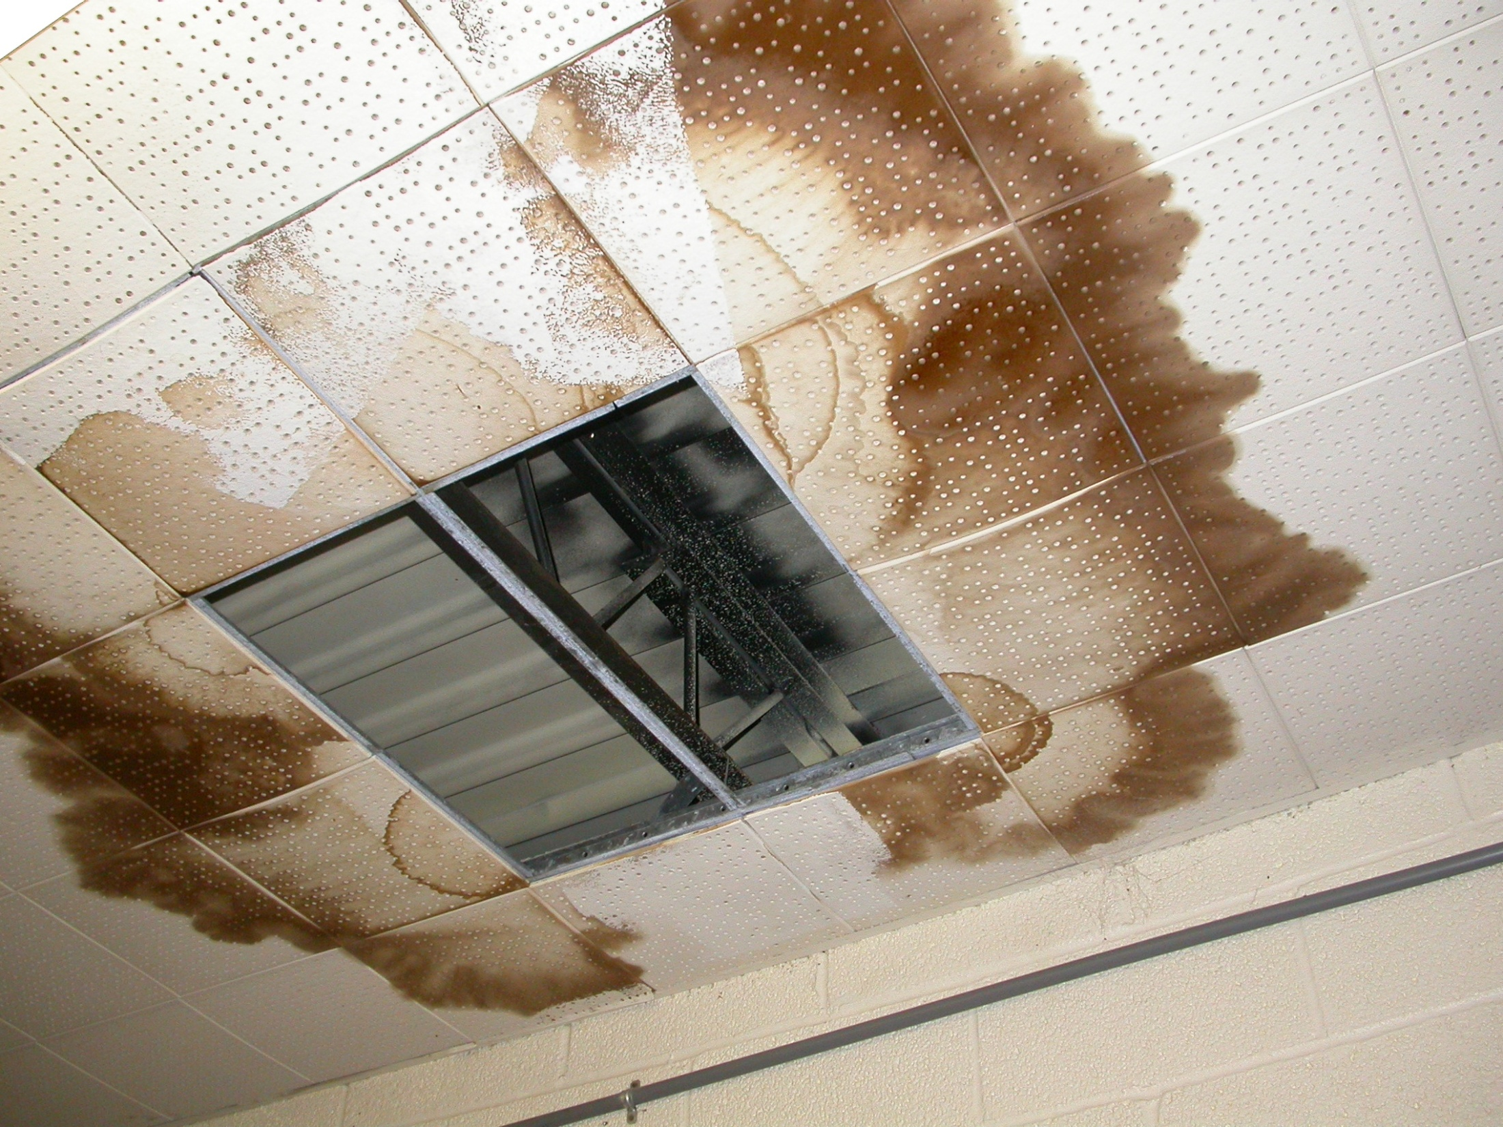

Slide 33
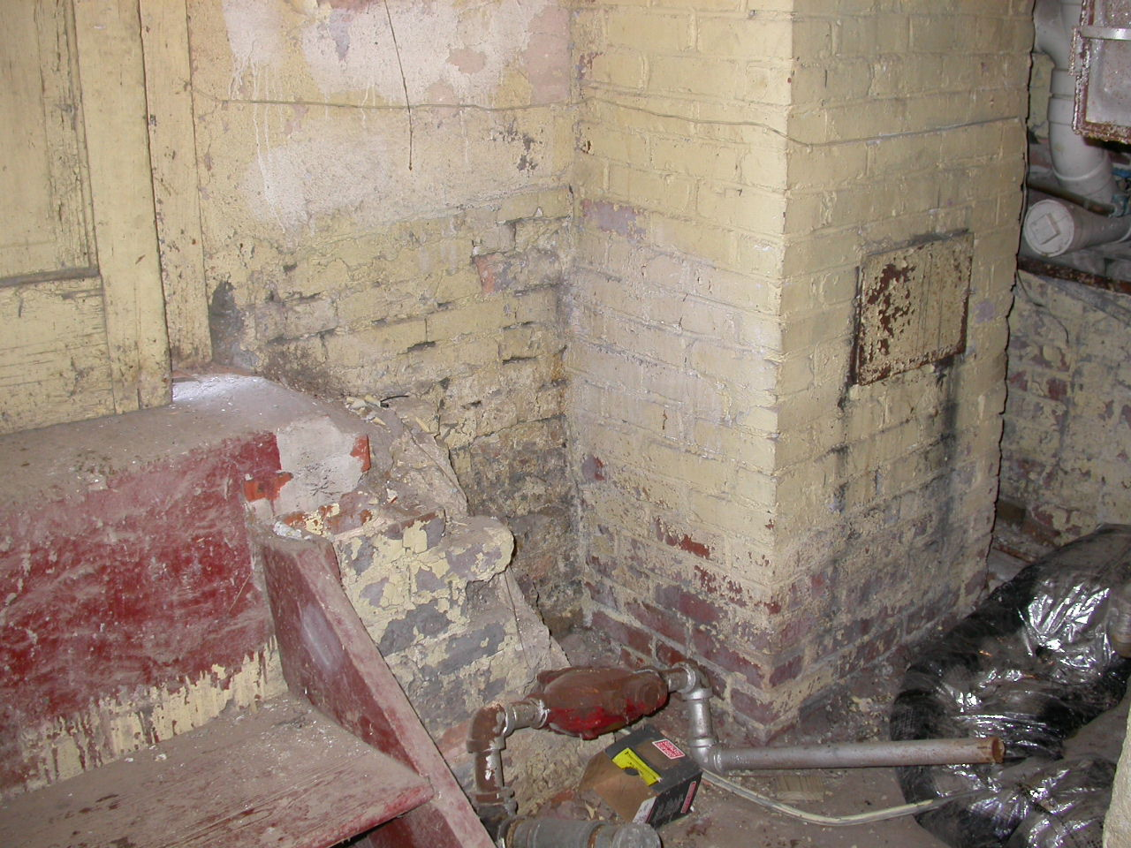

Slide 34
1932 James Hope Superintendent
General Report
“Until the problem is solved, South Carolina will never realize for her children the ideal that should be the goal in every democracy-equality of educational opportunity for every child.”

Slide 35
Journal of the House,
Gov. Robert E. McNair, Jan. 15, 1969
“Despite our increased commitment to education, we know that only one of every two children who enters the first grade in South Carolina will graduate from high school. Statistics tell us that one out of every ten children entering the first grade is so poorly prepared he will repeat that grade.”

Slide 36
2001 Edition Ranking of Counties and School Districts
Percentage of Students who enter the first grade, but don’t graduate from the twelfth.
  Dillon 2 52.4%
  Allendale 57.0%
  Lee 60.7%
  Hampton 2 61.9%

Slide 37
Gov. Richard W. Riley
January 11, 1984
“Industrial development truly begins in the classroom. Being 50th in support of education sends a message: it tells potential industries that we don’t expect much from ourselves or our future. It says that Georgia and North Carolina have more confidence in their children than we do.”

Slide 38

Rev. Dr. Martin Luther King, Jr.
“Injustice anywhere is a threat to justice everywhere. We are caught in an inescapable network of mutuality, tied in a single garment of destiny. Whatever affects one directly, affects all indirectly.”

Slide 39
LAW, JUSTICE, AND THE CONSTITUTION
South Carolina's
Unrealized Dream

